Slide 1
STANDALONE SEGMENT STUDIES: CALIBRATION AND RESOLUTION
Alberto Belloni, Kevin Black, George Brandenburg, Joao Guimaraes da Costa, Verena Martinez Outschoorn, Srivas Prasad
Muon Week, Software Session, 28 May 2009

Slide 2
Overview and Goals
May 28, 2009
Goal:
Validation: to extract intrinsic performance of segment fitting code, dependence on goodness of seed parameters
Performance w.r.t. calibration: to understand effect upon segment residuals of various t₀ and RT function effects:
  Using single t₀ per chamber
  Using out-of-date RT functions
  Not having temperature corrections to RT
Description:
ROOT-based description of single-chamber geometry
Generate and fit straight line segments
  Fit performed using Moore t₀ fit ported back from ATHENA
  RT calibration from Michigan Gas Monitoring
Muon Week, Software Session

Slide 3






PROCEDURE
II. Transform
III. Reconstruct
I. Generate
Define seed line for fit
Use hits defined in II
Use RT function RT_{rec}. Can be different from RT_{sim}. Examine:
  Temperature variation across wheel
  Change in calib over periods of time
Perform segment fits to get new hits (r_{o}, t_{o}) and line
May 28, 2009
Apply various imperfections to time:
Jitter/ToF
Different t₀ offsets for each mezzanine card
Bin time in TDC units
Then, get initial hits with time t_{i}, r_{i}=RT_{sim}(t_{i})
Make random straight line segments
Obtain true radius r_{t} of hits
And “true” time of hits t_{t} using R-T function RT_{sim}
Muon Week, Software Session

Slide 4
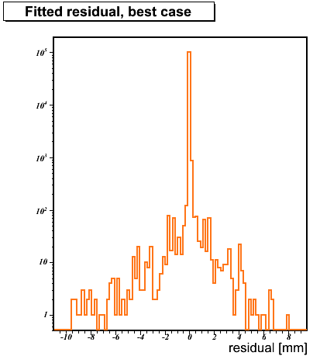
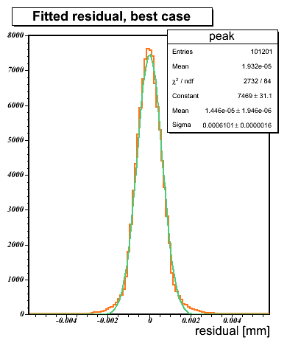


VALIDATION:
I) BEST CASE PERFORMANCE
Generate hits, perform no deformation,
  Seed line, hits are perfect
  Use same RT-function to generate and reconstruct hits
Central width is 0.6 μm (small!)
May 28, 2009
97% of hits in this plot
Muon Week, Software Session
σ: 0.6 μ m
5 Microns

Slide 5
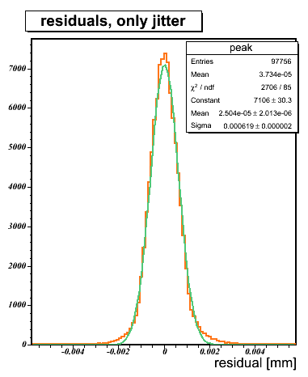
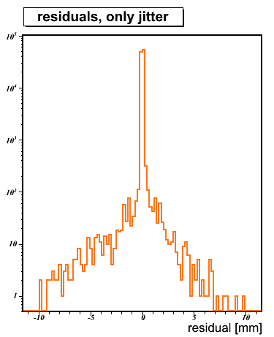
VALIDATION:
II) CORRECTION OF 25 NS JITTER (SLIDE 1/3)
Add a constant time offset to all hits
t_{i} = t_{t} + rand(-12.5, 12.5) [ns]
Everything else simulated as before
Central width is 0.6 μm – no degradation
t₀ refit fully corrects the jitter
May 28, 2009
Muon Week, Software Session
σ: 0.6 μ m
94% of hits in this plot

Slide 6
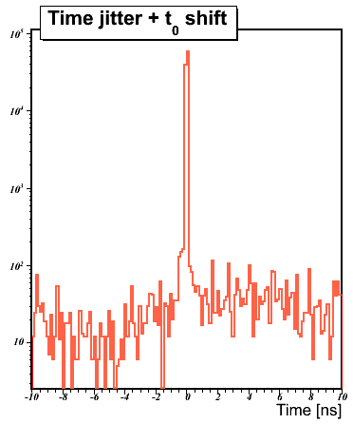
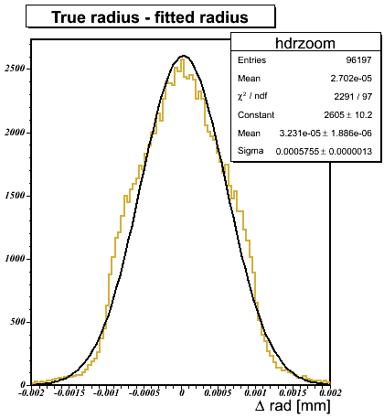

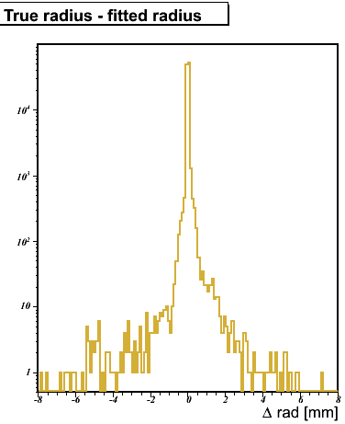

CORRECTION OF 25 NS JITTER (SLIDE 2/3)
t_{fitted} - t_{true} = time jitter + t₀ shift plot shows we are finding the right times / radii:
  93% of hits have fitted times within 50 ps of true time
  92% of hits have fitted radii within 2 μm of generated value
May 28, 2009
σ: 0.6 μ m
Muon Week, Software Session
92% of hits in this plot
2 Microns

Slide 7
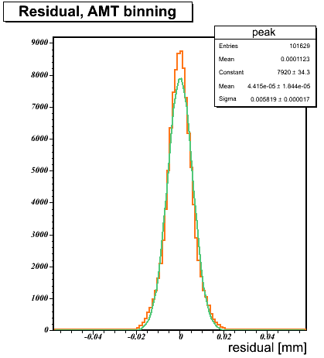
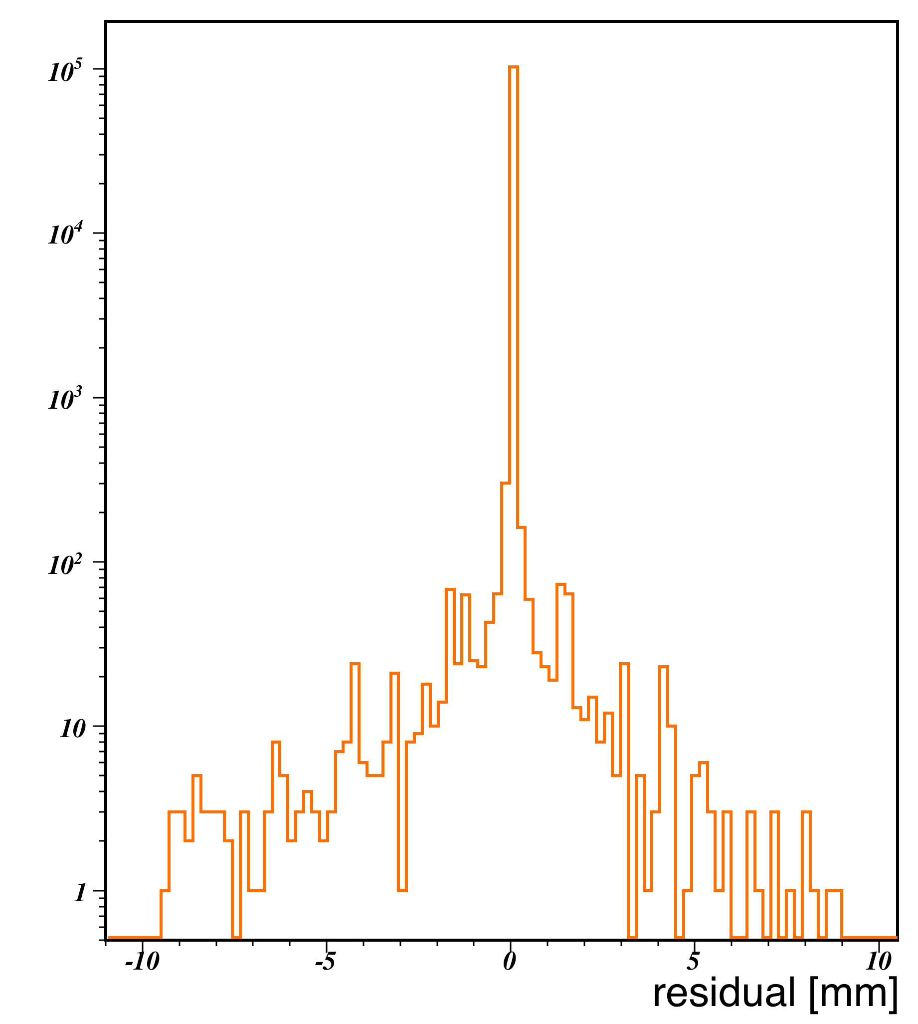

CORRECTION OF 25 NS JITTER (SLIDE 3/3)
COMPARE TO EFFECT OF DISCRETE ADC COUNTS
Times come in units of TDC fine time, or 0.78 ns
t_{i} = floor(t_{t}/0.78125 + 0.5) * 0.78125 [ns]
  Detector effect; fit cannot correct for this
Central width is 5.8 μm – eight times of jitter effect
  Plausible: 0.78 ns/√12 × (20 μm / ns) = 4.5 μm
May 28, 2009
Muon Week, Software Session
σ: 5.8 μ m

Slide 8
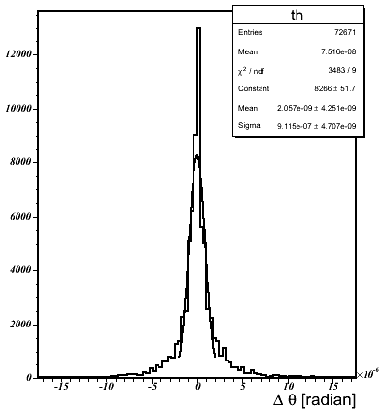

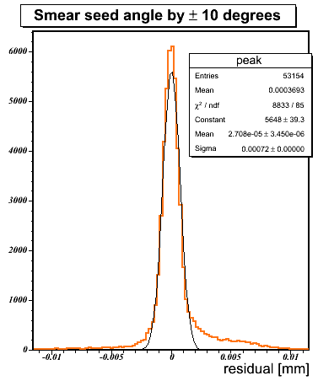
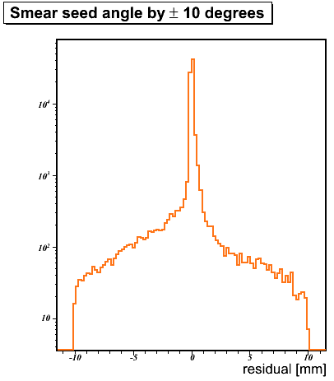
VALIDATION:
III) IMPERFECT SEED (ANGLE)
σ: 0.9 μ rad
Smear seed angle by [-10, 10] °
Central width not degraded, 0.7 μm
Larger tails (but still mostly contained within 10 μm)
In angle: 9 × 10⁻⁷ rad
May 28, 2009
Muon Week, Software Session
σ: 0.7 μ m
84% of hits in this plot

Slide 9
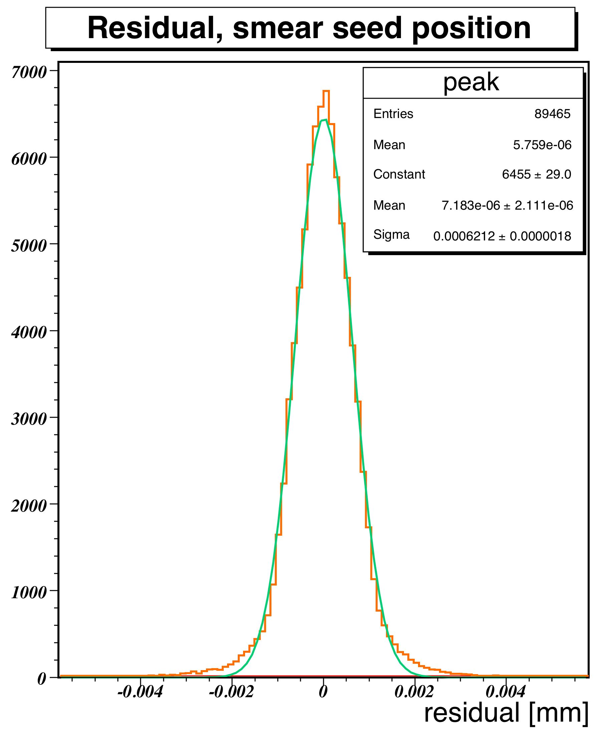
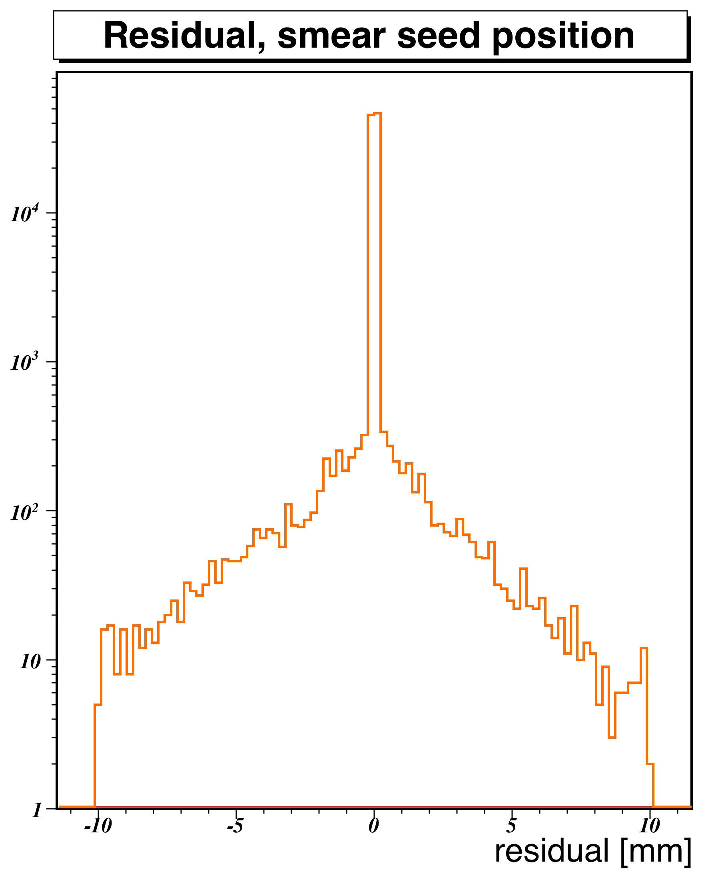

VALIDATION:
IV) IMPERFECT SEED (POSITION)
Move seed segment by [-3, 3] cm in each of x and y.
Again, performance undegraded, central width is 0.6 μm
Better performance than previous case – seed segment rotation affects far-off hits disproportionately (pre-fit residual can be 6-7 cm)
May 28, 2009
Muon Week, Software Session
σ: 0.6 μ m
91% of hits in this plot

Slide 10
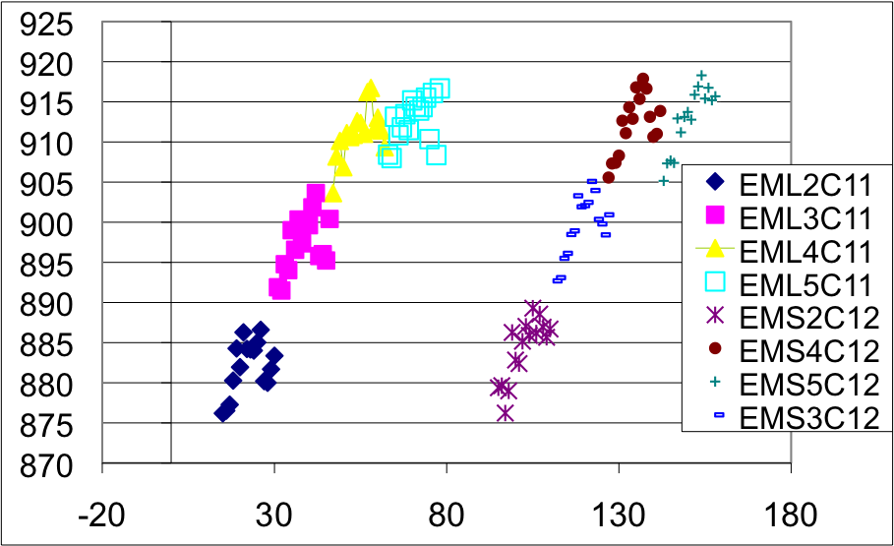
CALIBRATION AND RESIDUALS:
I) PER-MEZZANINE-CARD T₀ (SLIDE 1/4)
May 28, 2009
Conditions DB can store per-mezz card/tube t₀
Currently: often only per chamber information
See O(10 ns) spreads within individual chambers
Cannot be corrected for by segment-level t₀ shifts
t₀ for mezzanine cards, from M4 data
Effect smaller per segment –adjacent mezz cards have similar t₀’s.
Muon Week, Software Session

Slide 11
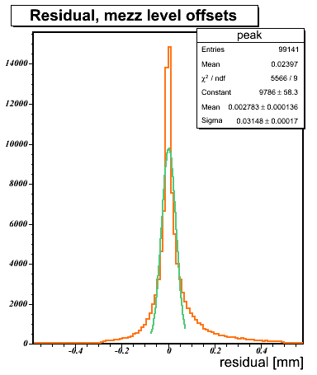
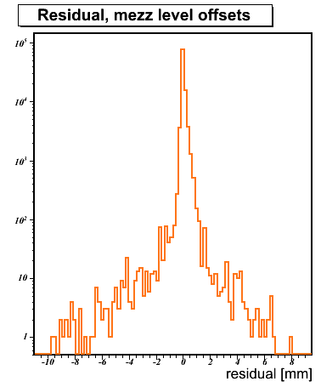
PER-MEZZANINE-CARD T₀ (SLIDE 2/4)
Introduce time offsets based on mezz-card number
    Get offsets from 2007 (M3), for EMS5C12:
    Offsets: (-7.69, -5.51, -5.16, -5.45, 0.09, -1.64, 0.27, 0.90, -0.06, 3.04, 4.08, 5.46, 2.57, 3.91, 2.35, 2.85) ns
Central width is 31 μm + large tails: effect depends on number of mezz cards crossed
May 28, 2009
σ: 31 μm
Muon Week, Software Session

Slide 12
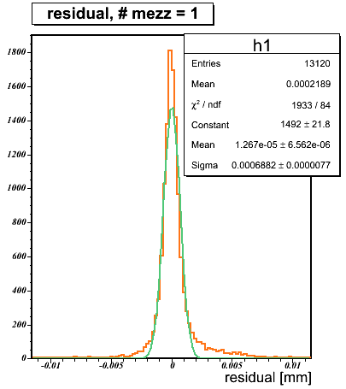
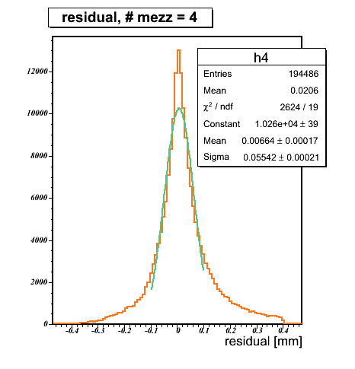

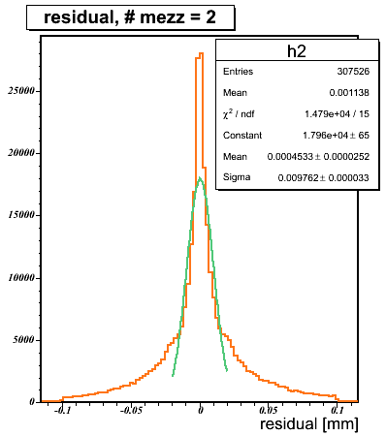

PER-MEZZANINE-CARD T₀ (SLIDE 3/4)
Effect worsens with number of mezz cards on segment
  σ = 10 μm, 27 μm, 55 μm, 74, 92 μm for Nmezz=2, 3, 4, 5, 8
N_{mezz}=1 is unaffected – another constant t₀ offset
May 28, 2009
σ: 0.7 μ m
σ: 55 μ m
Muon Week, Software Session
σ: 9.8 μ m

Slide 13
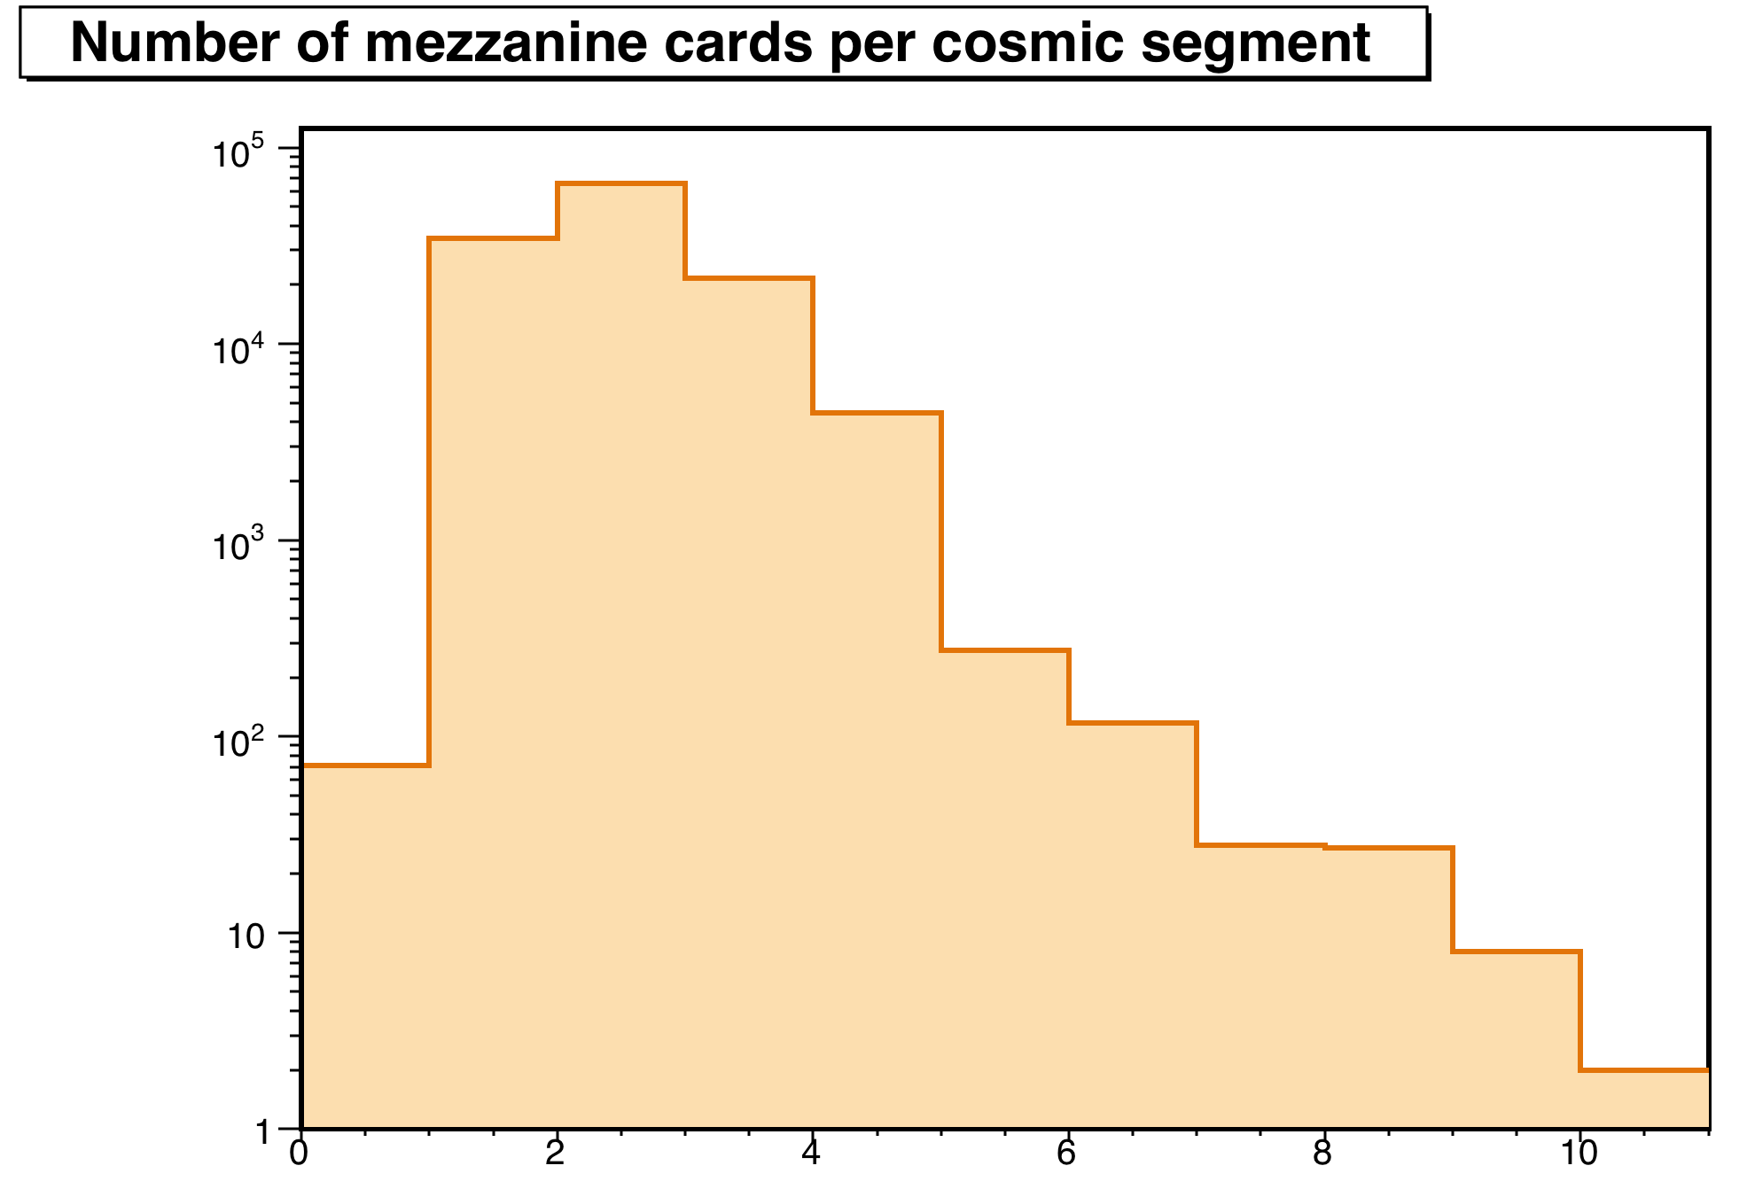
PER-MEZZANINE-CARD T₀ (SLIDE 4/4)
May 28, 2009
Muon Week, Software Session
Cosmics, run 91060 (All technologies)
Interestingly, ~25% of cosmic muons go through one mezzanine card (mostly 3-4 hit segments)
(N=0 is from bad identifiers)
Most probable effect of 10 μm

Slide 14
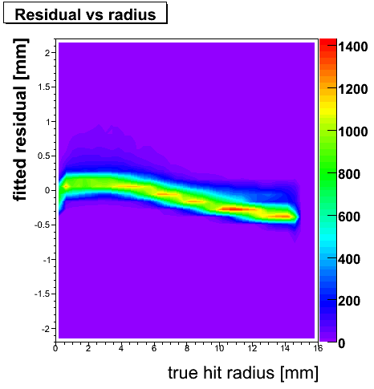
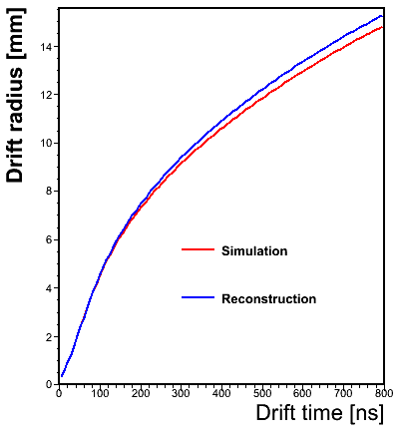
CALIBRATION AND RESIDUALS:
II) RT FUNCTION: TEMPERATURE EFFECTS (SLIDE 1/2)
5 K temperature variation between detector top and bottom
Dan Levin (Michigan) makes per-chamber RT-functions corrected for temperature variations
  Pick two most extreme RT functions for big wheel A (date: 20th February 2009)
  Simulate with one and reconstruct with other
May 28, 2009
Muon Week, Software Session
EMS1A12
EMS5A04

Slide 15
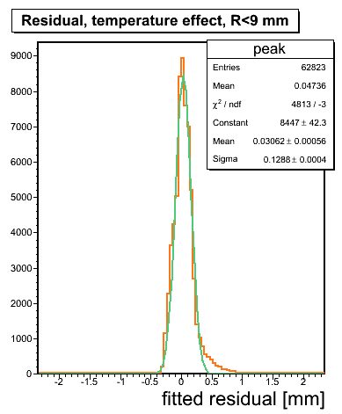
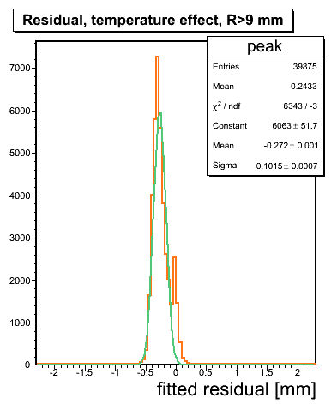
RT FUNCTION: TEMPERATURE EFFECTS (SLIDE 2/2)
Can expect to see >100 μm effects for the extreme cases when these temperature differences are not corrected for
Large radius hits are scaled down more, so there is a downward (upward) shift in mean residual at large r if the true RT function is colder (hotter)
May 28, 2009
σ: 101 μ m
Muon Week, Software Session
σ: 129 μ m

Slide 16
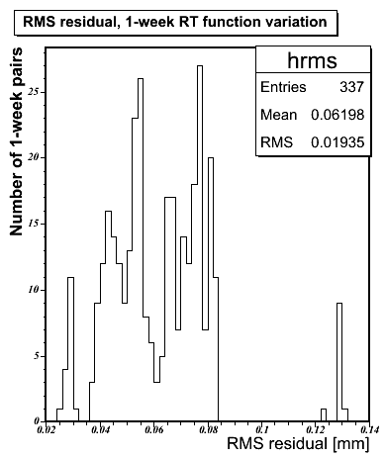
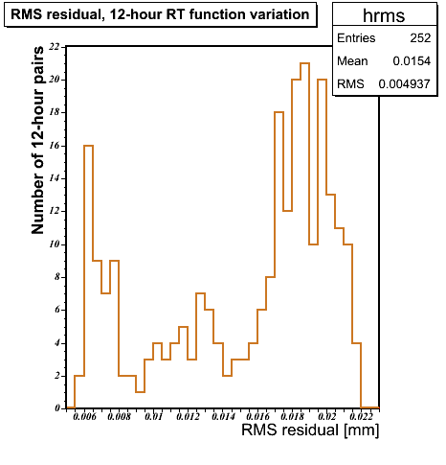



CALIBRATION AND RESIDUALS:
III) RT FUNCTION TIME VARIATION (SLIDE 1/2)
Probe effect of out-of-date RT calibration: take all pairs of RT functions this year 12 hours or a week apart.
Simulate segments with one, reconstruct with the other
RMS of residual distribution – typically 40-80 μm /week
From gas conditions – relates high impact on segment residual to RT function change / TDC spectra
May 28, 2009
One
Week difference
12-hour difference
Muon Week, Software Session
Corresponds to change in gas ~last week of March 2009

Slide 17
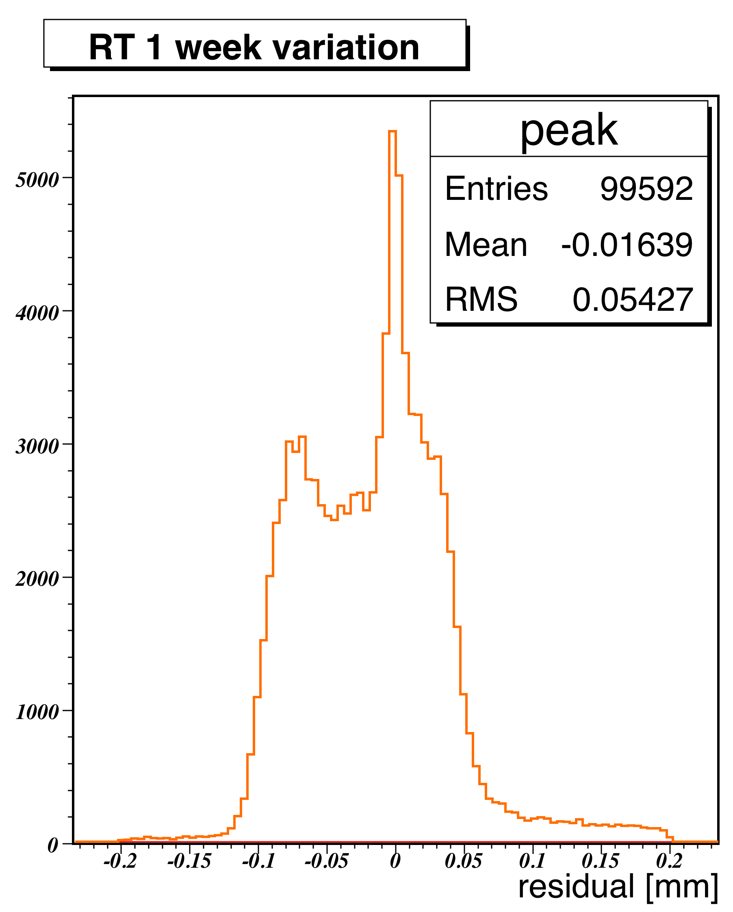
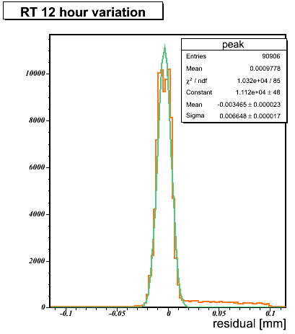

RT FUNCTION TIME VARIATION (SLIDE 2/2)
Example: simulate hits with an RT function ~ 3 AM, reconstruct using function 12 hours apart: 55 μm
Example: simulate with function from 26 Feb 2009, reconstruct with function from 5 March: 7 μm
Have uploaded animations as functions of time
May 28, 2009
σ: 6.6 μ m
Muon Week, Software Session

Slide 18
TABLE OF EFFECTS SEEN
# | Effect | Impact | Comments
1 | Intrinsic | 0.6 μm
2 | 25 ns Clock Jitter | 0.6 μm | No degradation w.r.t. 1
3 | AMT binning | 5.8 μm | Swamps intrinsic resolution and jitter
4 | Seed angle | 0.7 μm, 0.0009 mrad | Fit robust under imperfect seed
5 | Seed position | 0.6 μm | -do-
6 | Mezz card offsets | 0.7 μm, N=1 10 μm, N=2 27 μm, N=3 55 μm, N=4 | Creates a 10-50 micron effect
7 | Temperature | >≈100 μm, shifts in mean | (For extremes of temperature, BW A)
8 | Old RT relations “Passage of time” | 60 μm / week 10 μm in 12 hours | Very important to always have updated RT functions!
May 28, 2009
Muon Week, Software Session

Slide 19
CONCLUSION
Segment fitting has minimal impact upon residuals (0.6 μm), smaller effect than imposed by binning of hit times
No evidence seen that segment fitting causes large tails. See tails so far principally from imperfect RT calibration, and to a smaller extent from not using mezz-level t₀ information
Not using mezz-card level t₀ information provides 10-50 μm components to segment residual, depending on topology
Vital to have RT functions that are temperature corrected, and not out of date! Absence of either seems to make large tails
May 28, 2009
Muon Week, Software Session

Slide 20
BACKUP
May 28, 2009
Muon Week, Software Session

Slide 21
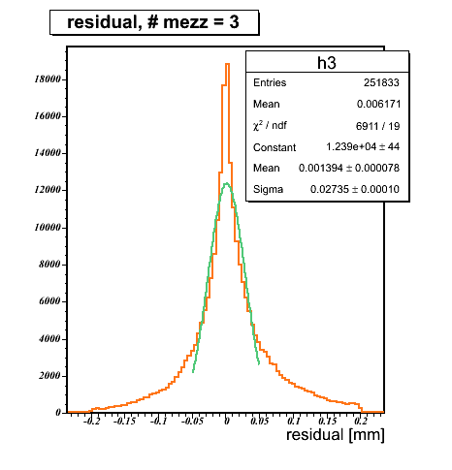
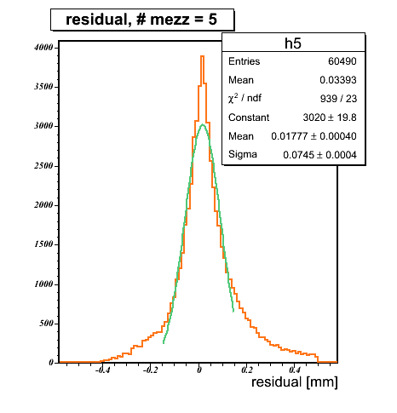



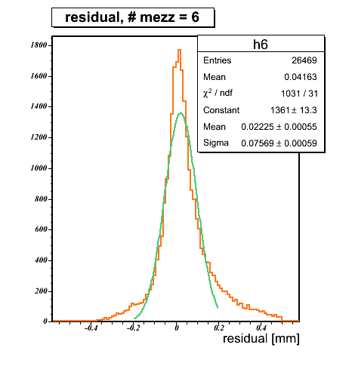
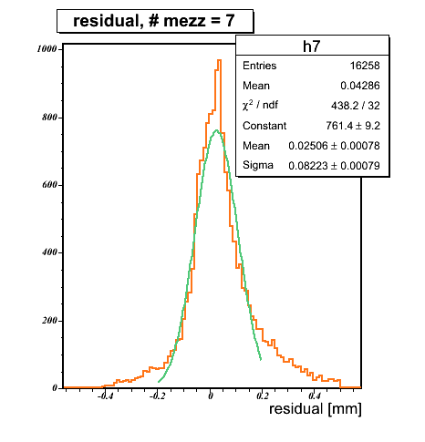
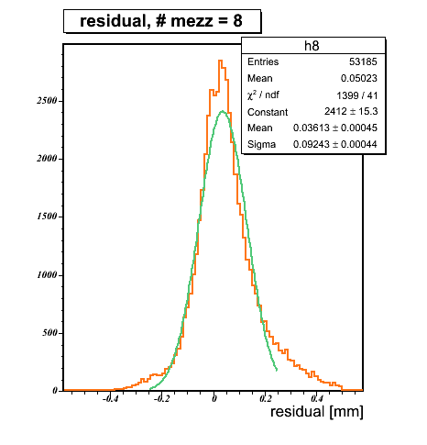


PER MEZZ PLOTS
27 μ m
55 μ m
74 μ m
May 28, 2009
76 μ m
82 μ m
92 μ m
Muon Week, Software Session
Residual vs number of mezz cards on segment

Slide 22
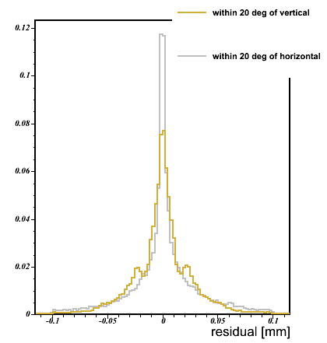

PER MEZZ PLOTS – ANGLE DISTRIBUTION
May 28, 2009
N_{mezz} = 2
Muon Week, Software Session
Residual curves for almost vertical/horizontal segments with two mezz cards on them
Using offsets

